Slide 1

Computer Organisation and Architecture
Appendix A – Digital Logic

Slide 2
Chapter Contents
A.1 Introduction
A.2 Combinational Logic
A.3 Truth Tables
A.4 Logic Gates
A.5 Properties of Boolean Algebra
A.6 The Sum-of-Products Form and Logic Diagrams
A.7 The Product-of-Sums Form
A.11 Sequential Logic

Slide 3
Introduction
Introduction to gate/logic symbol, truth tables and boolean expressions (use to guide us in building logic circuits) for each logic gate and know how to convert from one form to another

Slide 4
Some Definitions
Combinational logic: a digital logic circuit in which logical decisions are made based only on combinations of the inputs. e.g. an adder.
  Is an interconnection of logic gates to generate a specified logic function where the inputs result in an immediate output; having no memory or storage capabilities
  You will be combining gates (ANDs,ORs) and inverters to solve logic problems that do not require memory.
Sequential logic: a circuit in which decisions are made based on combinations of the current inputs as well as the past history of inputs. e.g. a memory unit

Slide 5
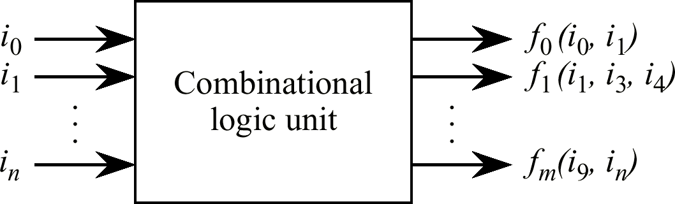
The Combinational Logic Unit
Translates a set of inputs into a set of outputs according to one or more mapping functions.
Inputs and outputs for a CLU normally have two distinct (binary) values: high and low, 1 and 0, 0 and 1, or 5 V. and 0 V. for example.
The outputs of a CLU are strictly functions of the inputs, and the outputs are updated immediately after the inputs change. A set of inputs i₀ – i_{n} are presented to the CLU, which produces a set of outputs according to mapping functions f₀ – f_{m.}

Slide 6
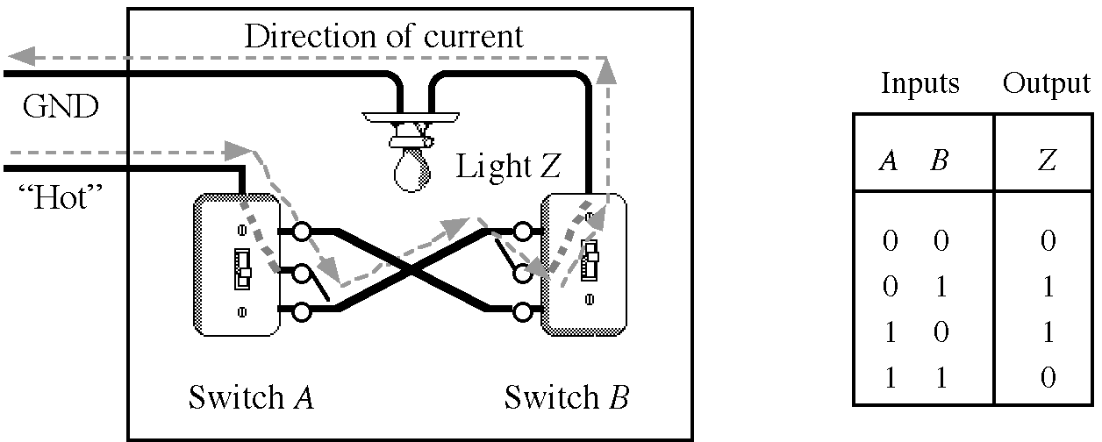
Truth Tables
Developed in 1854 by George Boole
further developed by Claude Shannon (Bell Labs)
Outputs are computed for all possible input combinations (how many input combinations are there?
Consider a room with two light switches. How must they work†?
†Don't show this to your electrician, or wire your house this way. This circuit definitely violates the electric code. The practical circuit never leaves the lines to the light "hot" when the light is turned off. Can you figure how?

Slide 7
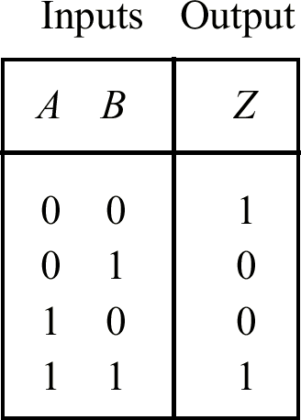
Alternate Assignments of Outputs to Switch Settings
Logically identical truth table to the original (see previous slide), if the switches are configured up-side down.

Slide 8
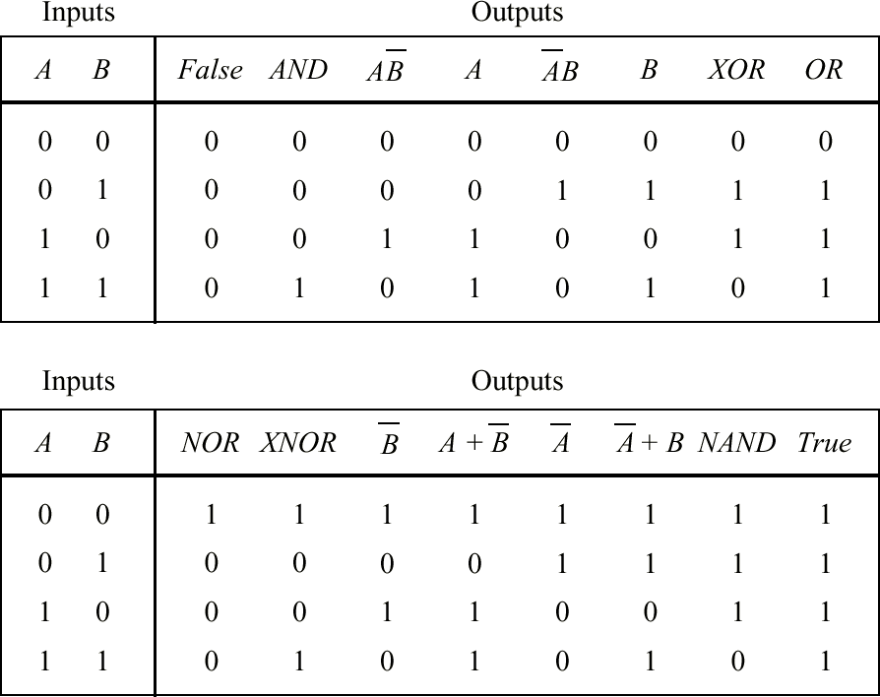
Truth Tables Showing All Possible Functions of Two Binary Variables
The more frequently used functions have names: AND, XOR, OR, NOR, XOR, and NAND. (Always use upper case spelling.)

Slide 9
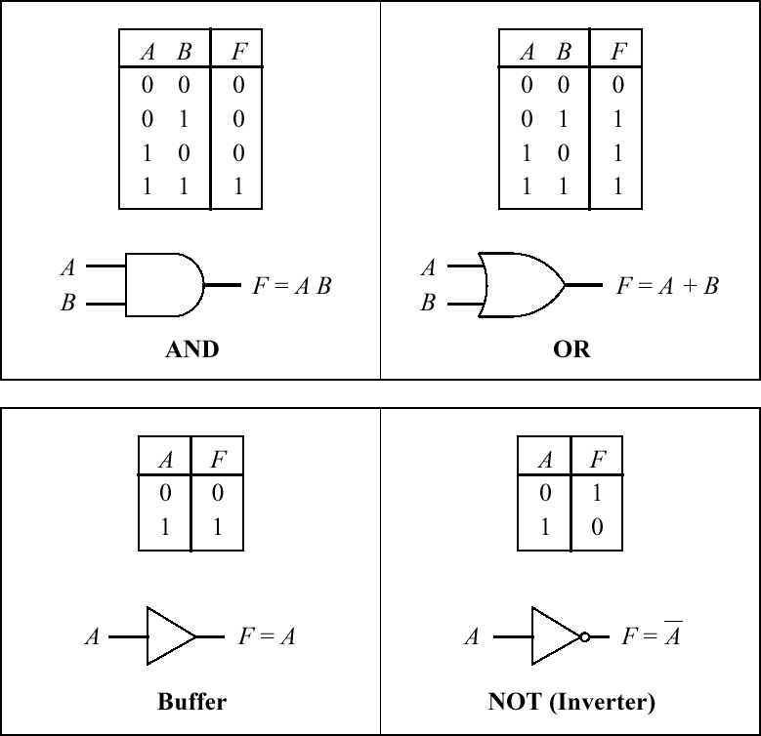
Logic Gates and Their Symbols
Logic symbols for AND, OR, buffer, and NOT Boolean functions
Note the use of the “inversion bubble.”
(Be careful about the “nose” of the gate when drawing AND vs. OR.)

Slide 10
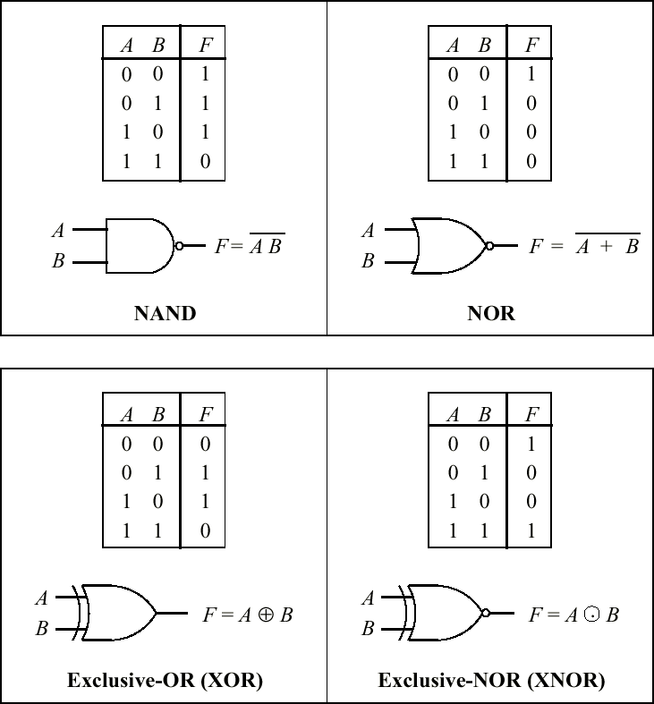
Logic symbols for NAND, NOR, XOR, and XNOR Boolean functions

Slide 11
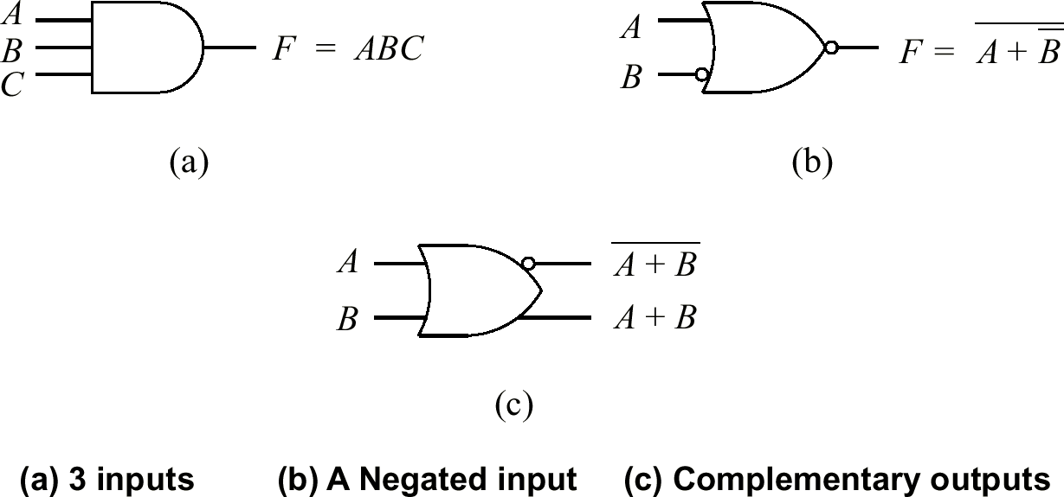
Variations of Basic Logic Gate Symbols

Slide 12
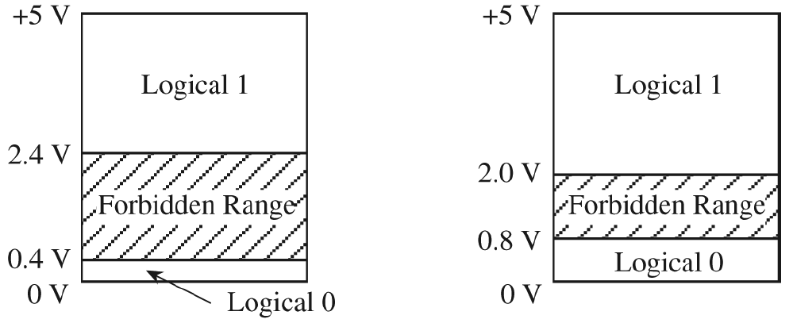
Allowable Voltages in Transistor-Transistor-Logic (TTL)
Assignments of logical 0 and 1 to voltage ranges (left) at the output of a logic gates, (right) at the input to a logic gate.

Slide 13
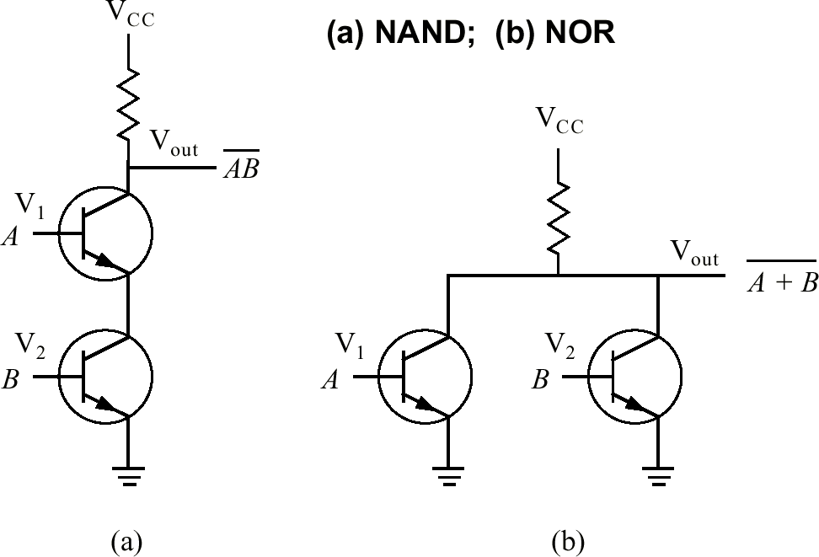
Transistor-Level Circuits For
2-Input NAND and NOR Gates

Slide 14
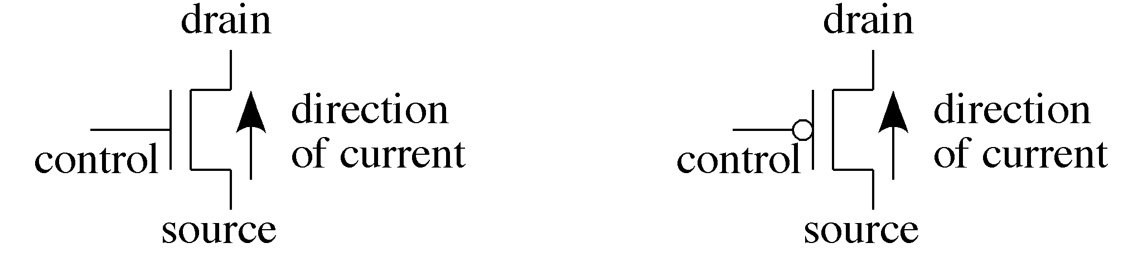
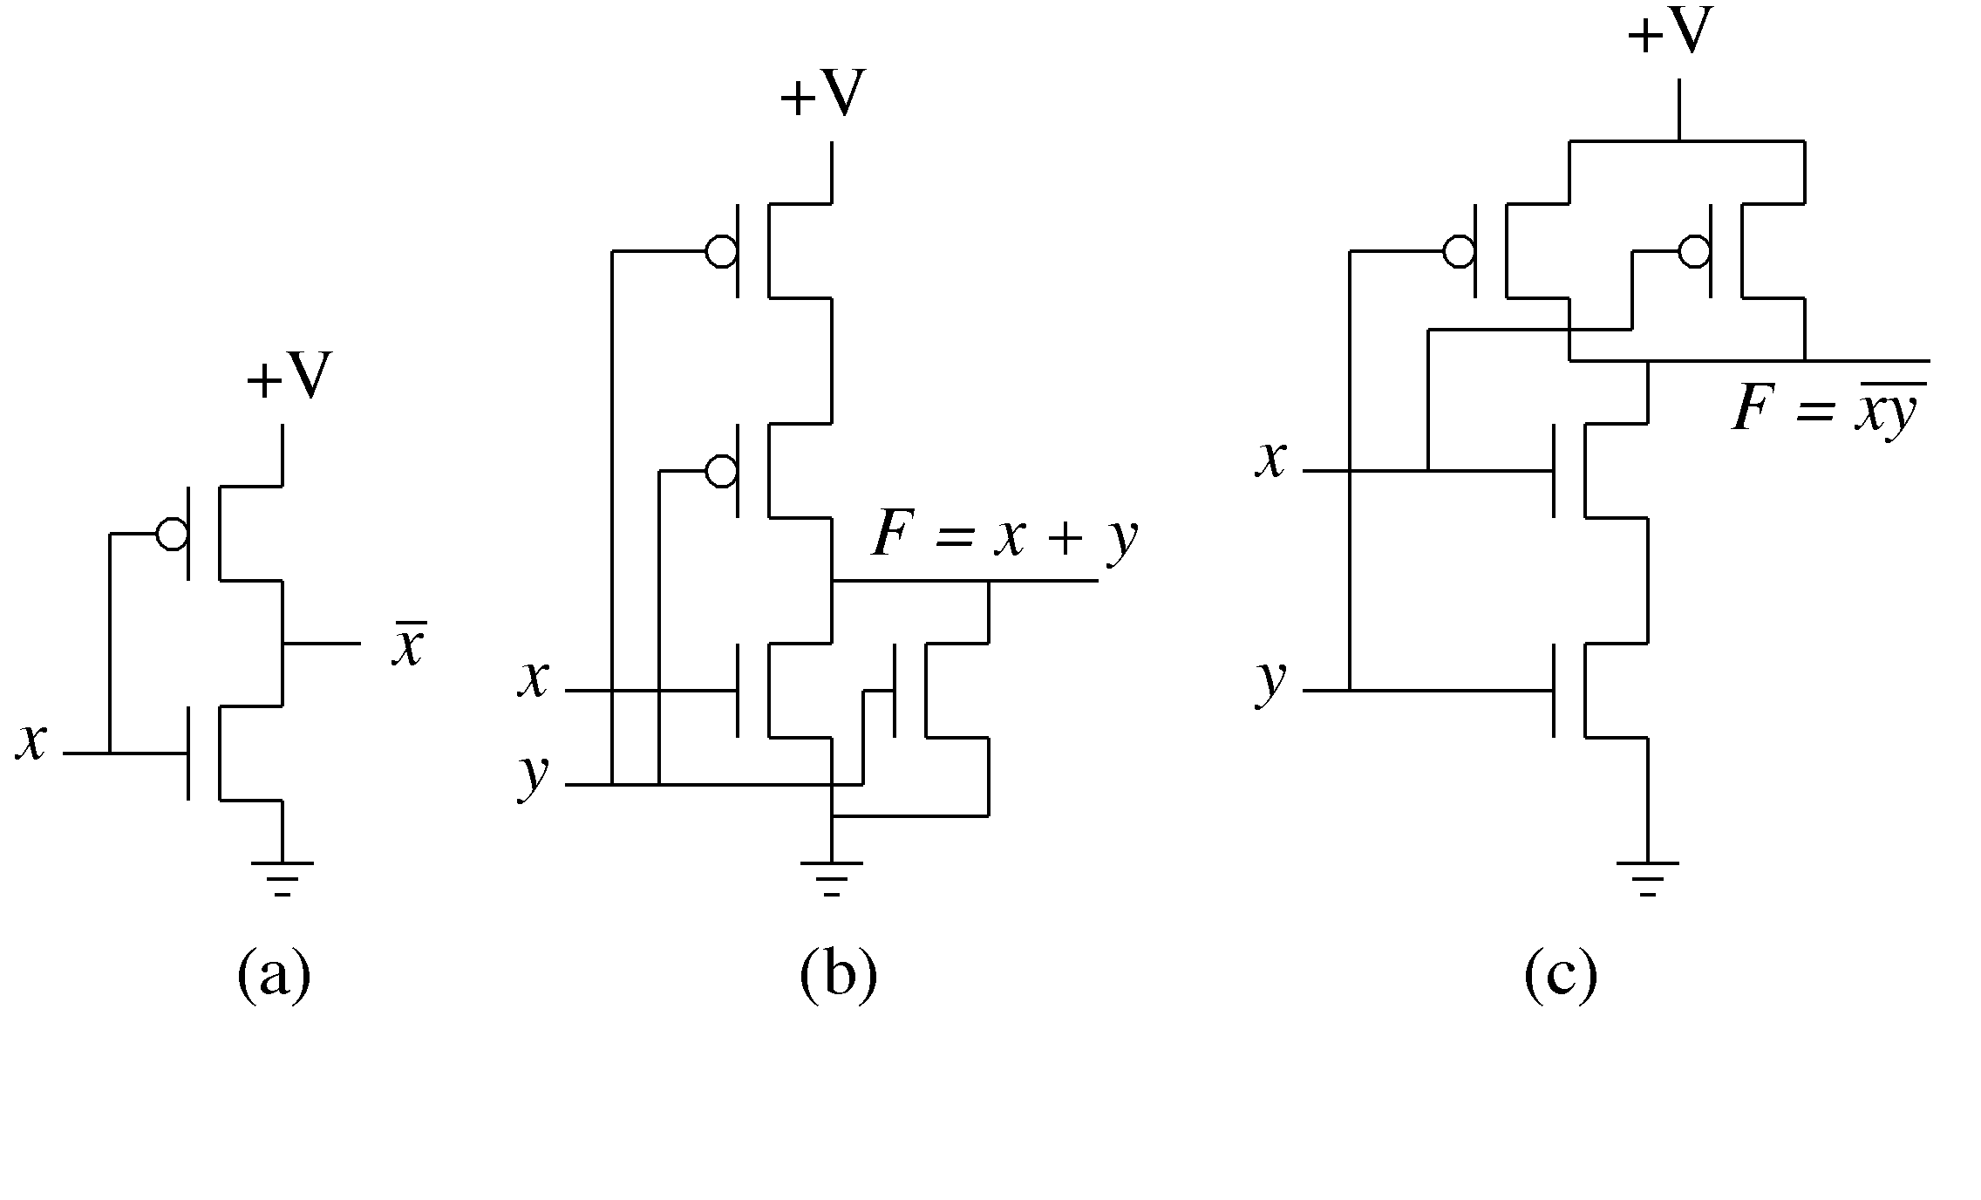
CMOS Configurations
Schematic symbols for (left) n-channel transistor and (right) p-channel transistor.
CMOS configurations for (a) NOT, (b) NOR, and (c) NAND gates.

Slide 15
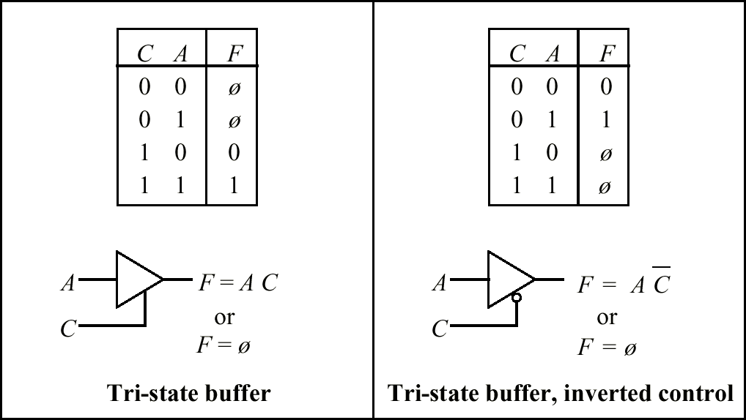
Tri-State Buffers
Outputs can be 0, 1, or “electrically disconnected.”

Slide 16
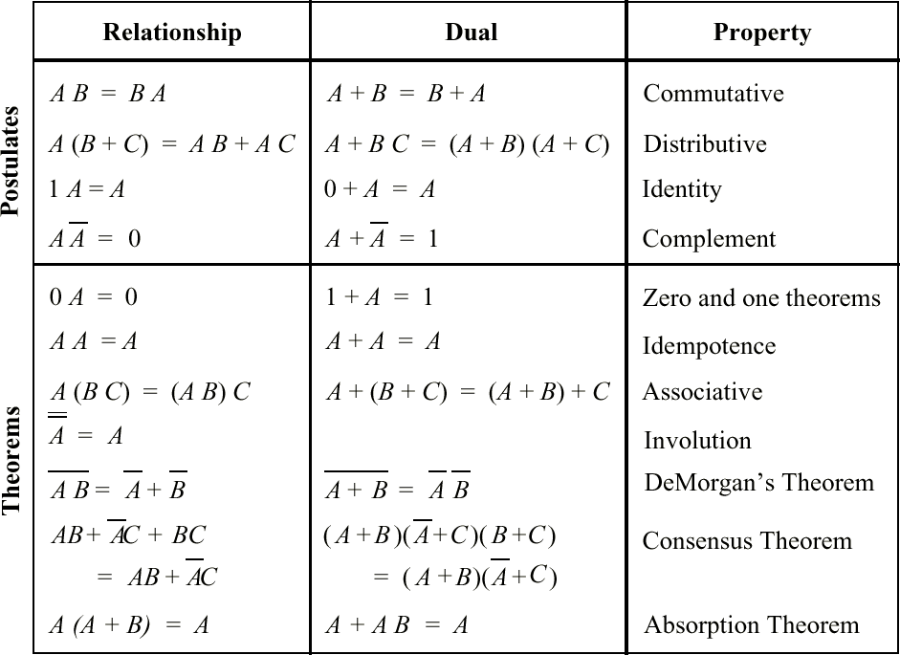
The Basic Properties of Boolean Algebra
Principle of duality: The dual of a Boolean function is made by replacing AND with OR and OR with AND, constant 1s by 0s, and 0s by 1s
A, B, etc. are literals; 0 and 1 are constants.

Slide 17
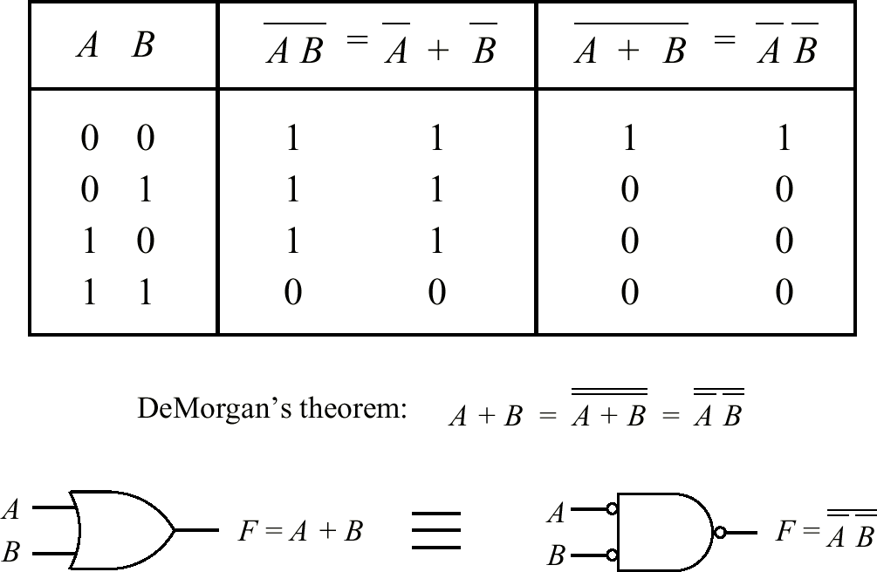
DeMorgan’s Theorem
Discuss: Applying DeMorgan’s theorem by “pushing the bubbles,” and “bubble tricks.”

Slide 18
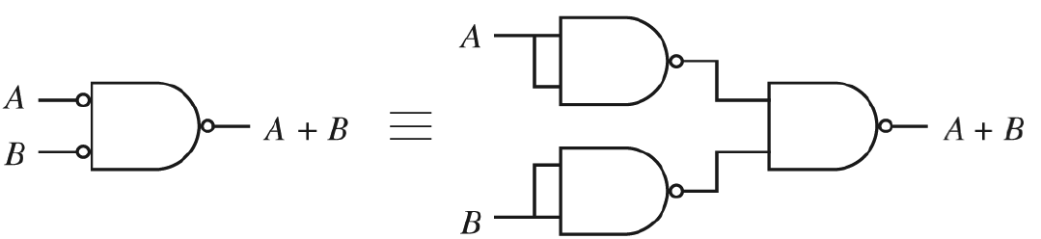
NAND Gates Can Implement AND and OR Gates
Inverted inputs to a NAND gate are implemented with NAND gates.

Slide 19
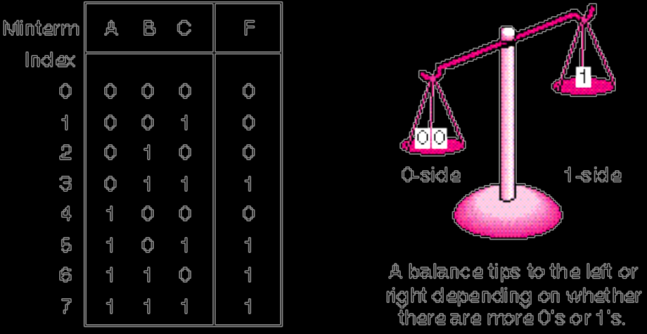
The Sum-of-Products (SOP) Form
Truth Table for The Majority Function
Transform the function into a two-level AND-OR equation
Implement the function with an arrangement of logic gates from the set {AND, OR, NOT}
M is true when A=0, B=1, and C=1, or when A=1, B=0, and C=1, and so on for the remaining cases.
Represent logic equations by using the sum-of-products (SOP) form

Slide 20
The SOP Form of the Majority Gate
The SOP form for the 3-input majority gate is:
M = ABC + ABC + ABC + ABC = m3 + m5 +m6 +m7 = Σ (3, 5, 6, 7)
Each of the 2^{n} terms are called minterms, running from 0 to 2^{n} - 1
Note the relationship between minterm number and boolean value.
Discuss: common-sense interpretation of equation.

Slide 21
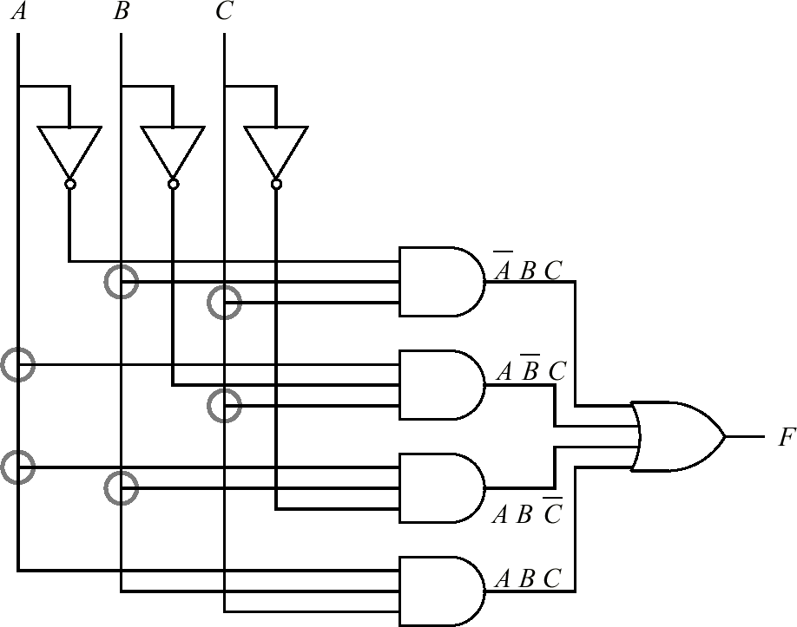
A 2-Level AND-OR Circuit Implements the Majority Function
The encircled “T” intersections are electrically common (see next slide).
Notes:
Ok….guna

Slide 22
Reduction (Simplification) of Boolean Expressions
• It is often possible to simplify the canonical SOP (or POS) forms.
• A smaller Boolean equation generally translates to a lower gate count in the target circuit.
• We cover three methods: algebraic reduction, Karnaugh map reduction, and tabular (Quine-McCluskey) reduction.
Notes:
ok

Slide 23
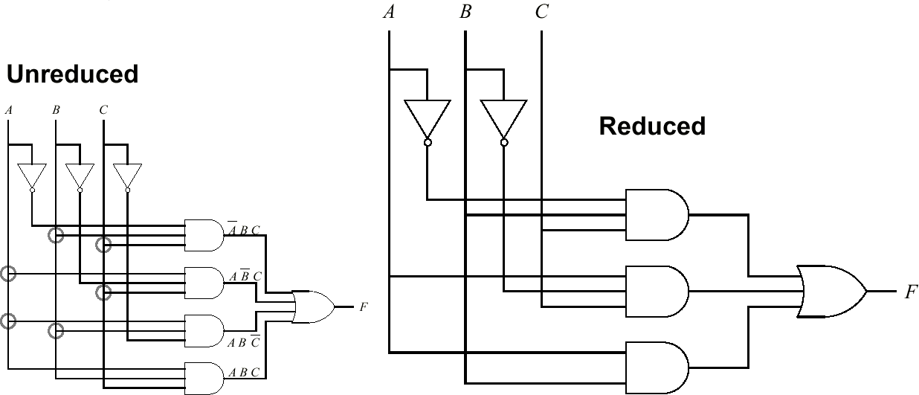
Reduced Majority Function Circuit
  • Compared with the AND-OR circuit for the unreduced majority function, the inverter for C has been eliminated, one AND gate has been eliminated, and one AND gate has only two inputs instead of three inputs. Can the function by reduced further? How do we go about it?

Slide 24
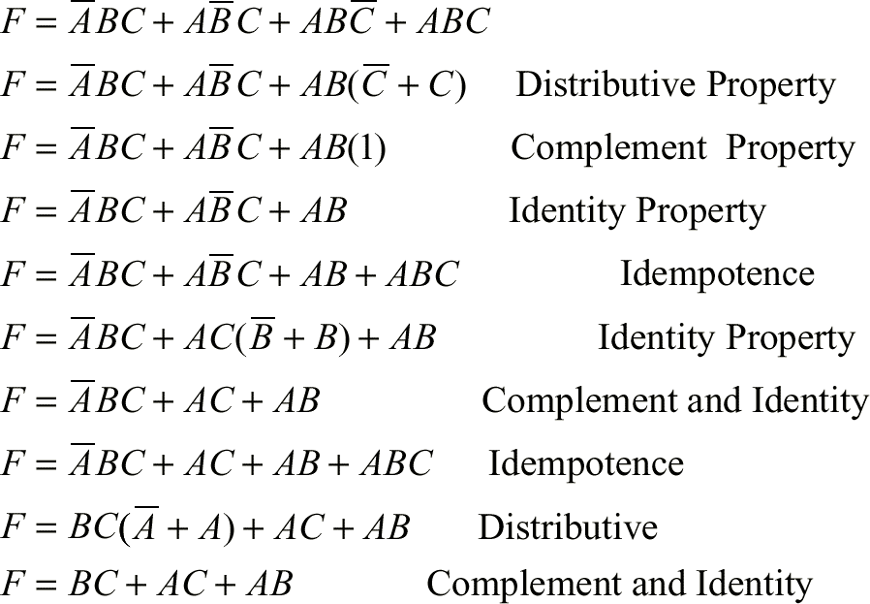
The Algebraic Method
  • Consider the majority function, F. We apply the algebraic method to reduce F to its minimal two-level form:

Slide 25
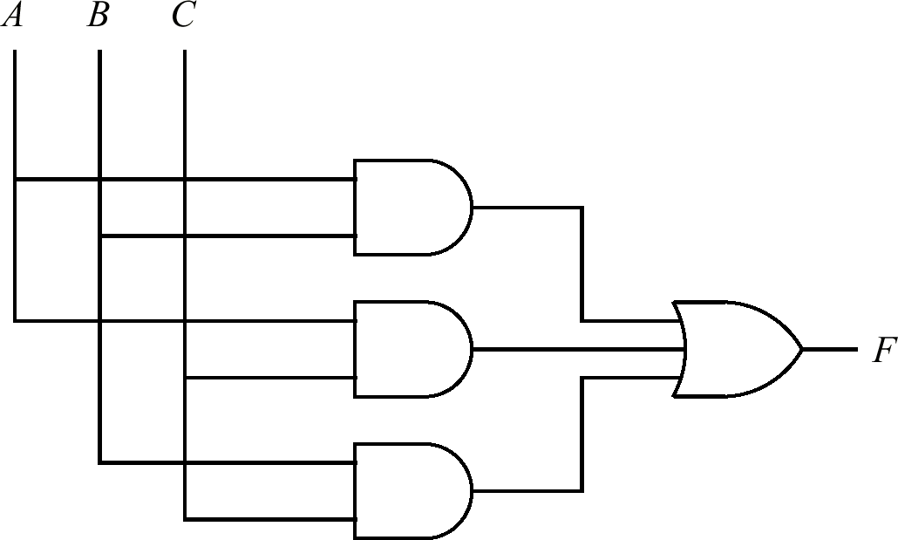
The Algebraic Method
  • This majority circuit is functionally equivalent to the previous majority circuit, but this one is in its minimal two-level form:

Slide 26
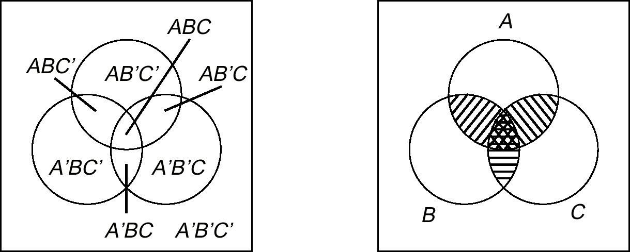
Karnaugh Maps: Venn Diagram Representation of Majority Function
• Each distinct region in the “Universe” represents a minterm.
• This diagram can be transformed into a Karnaugh Map.
Notes:
a graphical technique to visualize the minterms in a function along with variables that are common to them
efficient for expression max 6 inputs, more complicated use Quine-McKluskey method

Slide 27
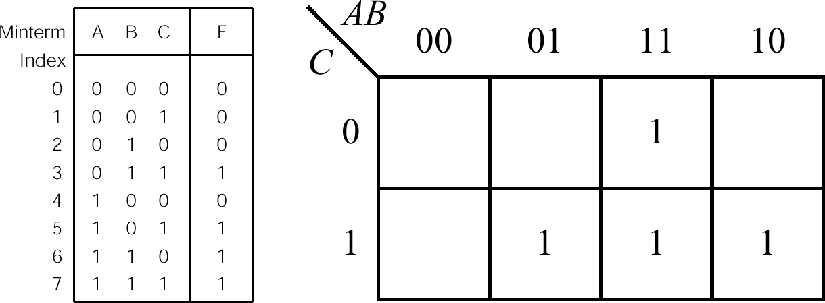
K-Map for Majority Function
• Place a “1” in each cell that corresponds to that minterm.
• Cells on the outer edge of the map “wrap around”
Notes:
Minterms – minimum number of terms (one) will make the function true.
True = 1 = A
False = 0 = A’
Remember the outlay of the map (00, 01, 11, 10) = (A’B’, A’B, AB, AB’)
Take not on the changes on the input value.

Slide 28
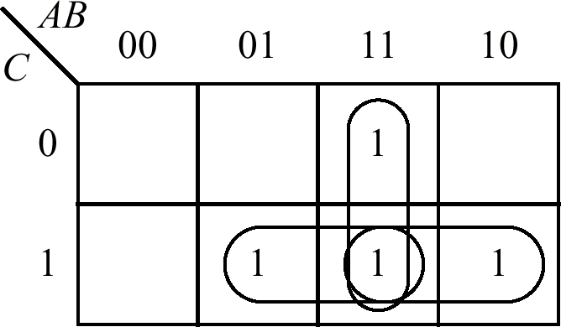
Adjacency Groupings for Majority Function
  • F = BC + AC + AB
Notes:
Grouping of 1, 2, 4, 8, …..
F= (A’BC + ABC) + (ABC’ + ABC) + (ABC + AB’C)
= (BC(A’ + A)) + (AB(C’+C)) + (AC(B+B’)) --- distributive property ( A(B+C) = AB + AC )
= BC + AB + AC --- complement property ( A + A’ = 1 )

Slide 29
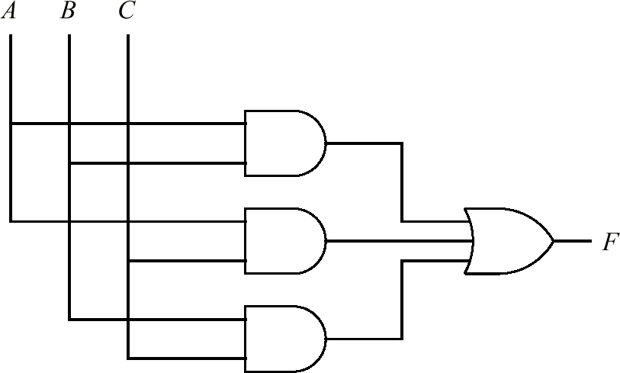
Minimized AND-OR Majority Circuit
  • F = BC + AC + AB
  • The K-map approach yields the same minimal two-level form as the algebraic approach.

Slide 30
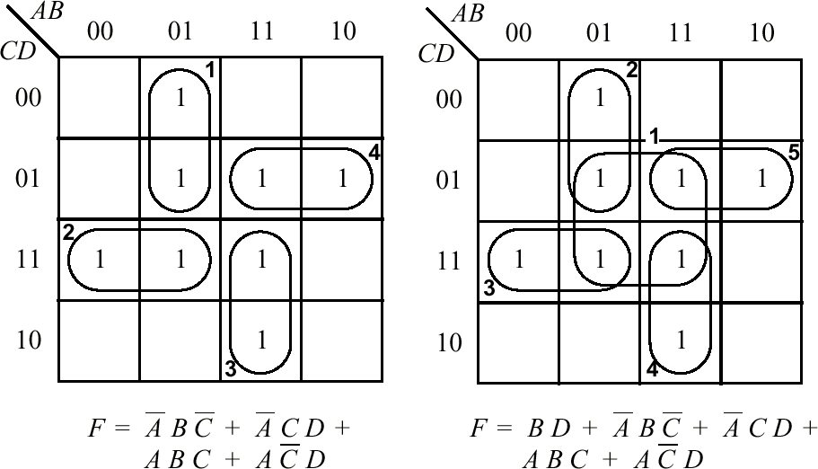
K-Map Groupings
  • Minimal grouping is on the left, non-minimal (but logically equivalent) grouping is on the right.
  • To obtain minimal grouping, create smallest groups first.
Notes:
2 important things to remember,
Group the 1’s in minimal manner
Discard changing input

Slide 31
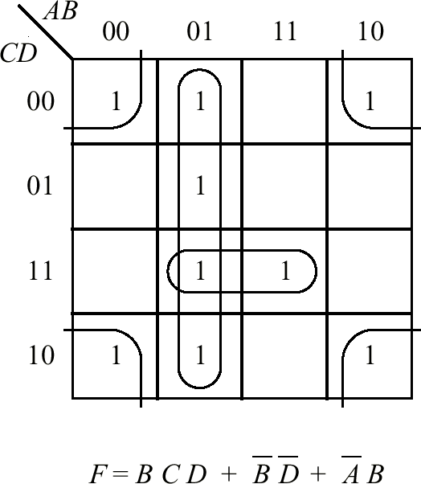
K-Map Corners are Logically Adjacent

Slide 32
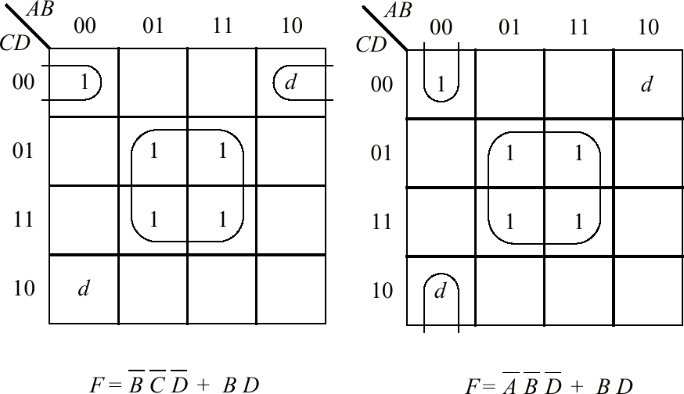
K-Maps and Don’t Cares
  • There can be more than one minimal grouping, as a result of don’t cares.
Notes:
Ok…

Slide 33
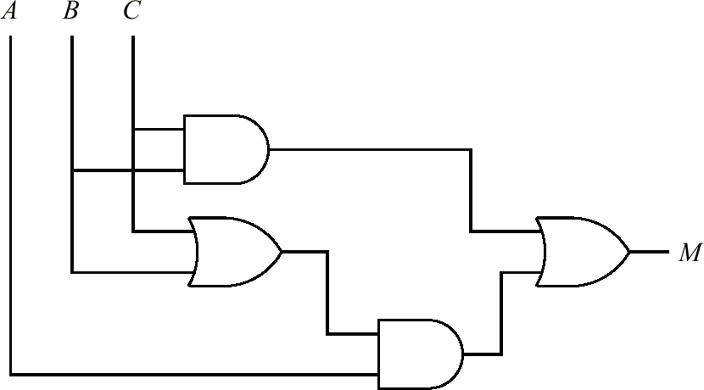
3-Level Majority Circuit
  • K-Kap Reduction results in a reduced two-level circuit (that is, AND followed by OR. Inverters are not included in the two-level count). Algebraic reduction can result in multi-level circuits with even fewer logic gates and fewer inputs to the logic gates.
Notes:
Cth lain….

Slide 34
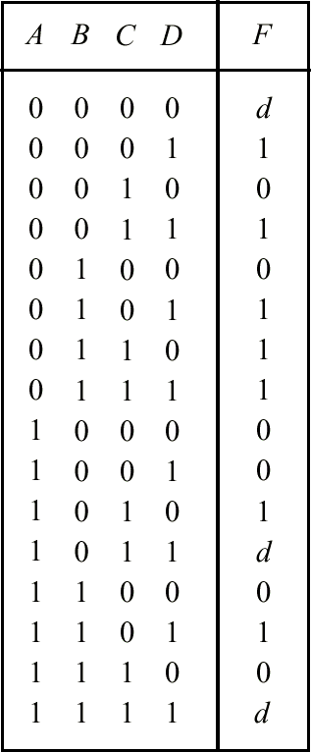
Truth Table with Don’t Cares
  • A truth table representation of a single function with don’t cares.

Slide 35
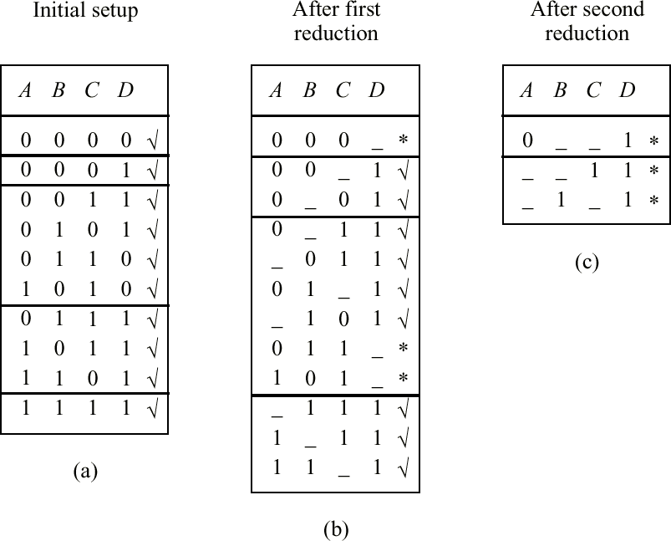
Tabular (Quine-McCluskey) Reduction
  • Tabular reduction begins by grouping minterms for which F is nonzero according to the number of 1’s in each minterm. Don’t cares are considered to be nonzero.
  • The next step forms a consensus (the logical form of a cross product) between each pair of adjacent groups for all terms that differ in only one variable.

Slide 36
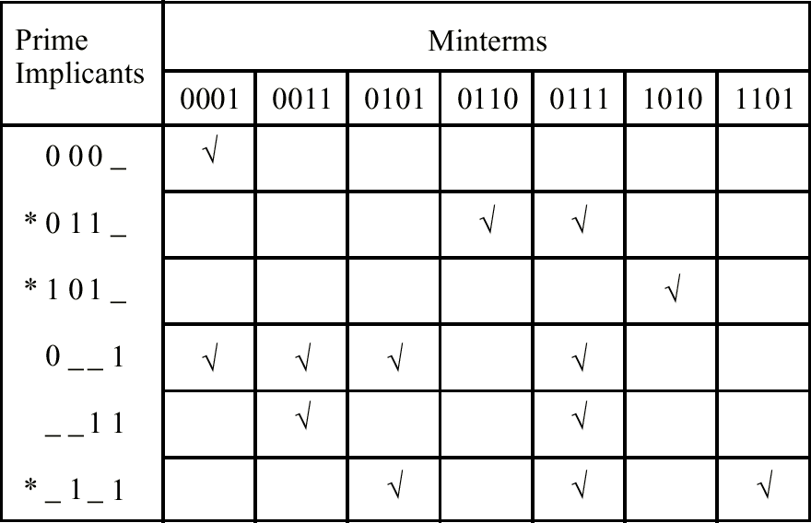
Table of Choice
  • The prime implicants form a set that completely covers the function, although not necessarily minimally.
  • A table of choice is used to obtain a minimal cover set.

Slide 37
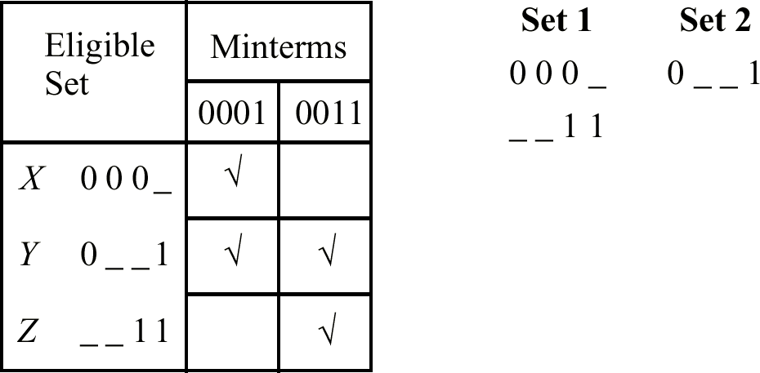
Reduced Table of Choice
  • In a reduced table of choice, the essential prime implicants and the minterms they cover are removed, producing the eligible set.
  • F = ABC + ABC + BD + AD

Slide 38
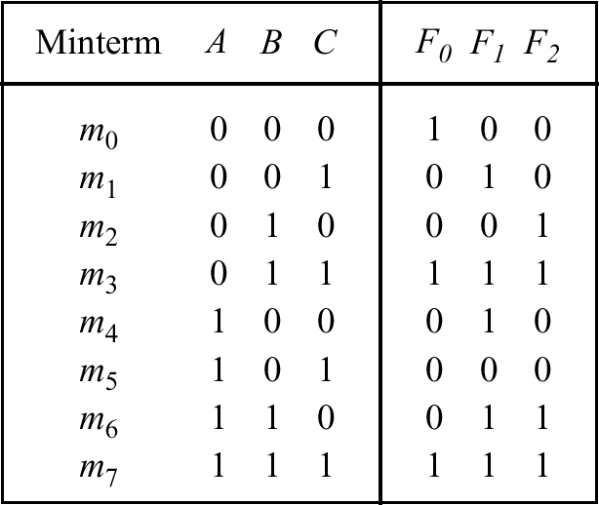
Multiple Output Truth Table
  • The power of tabular reduction comes into play for multiple functions, in which minterms can be shared among the functions.

Slide 39
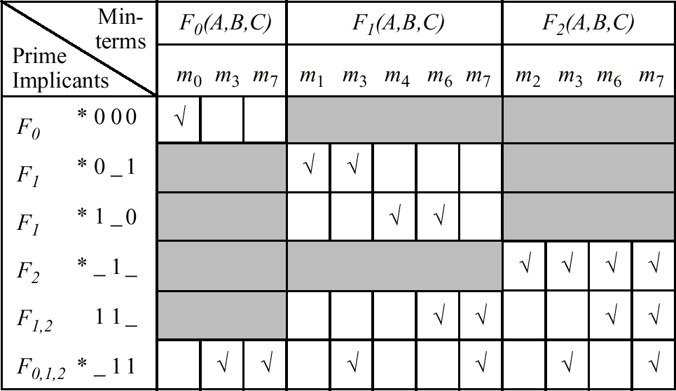
Multiple Output Table of Choice
  F₀(A,B,C) = ABC + BC
  F₁(A,B,C) = AC + AC + BC
  F₂(A,B,C) = B

Slide 40
Speed and Performance
  The speed of a digital system is governed by:
the propagation delay through the logic gates, and
the propagation delay across interconnections.
  We will look at characterizing the delay for a logic gate, and a method of reducing circuit depth using function decomposition.

Slide 41
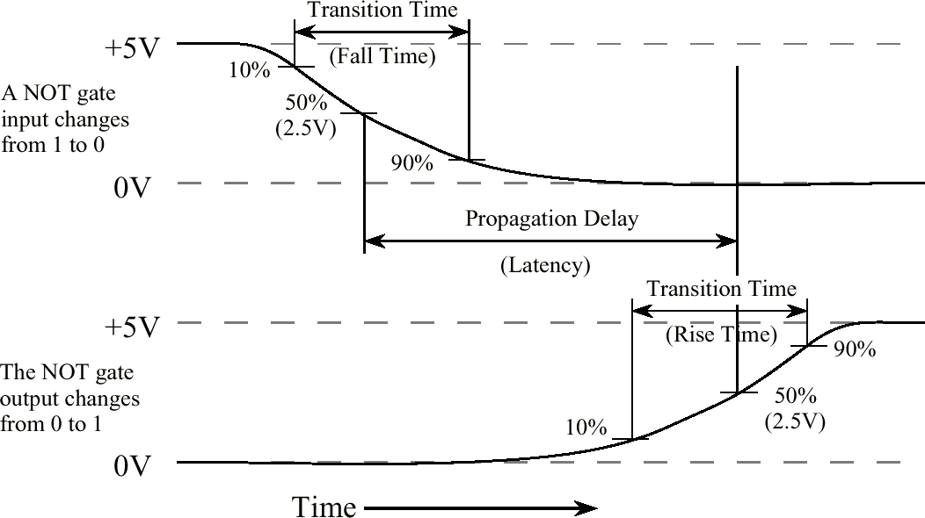
Propagation Delay for a NOT Gate
  • (Adapted from: Hamacher et. al. 2001)

Slide 42
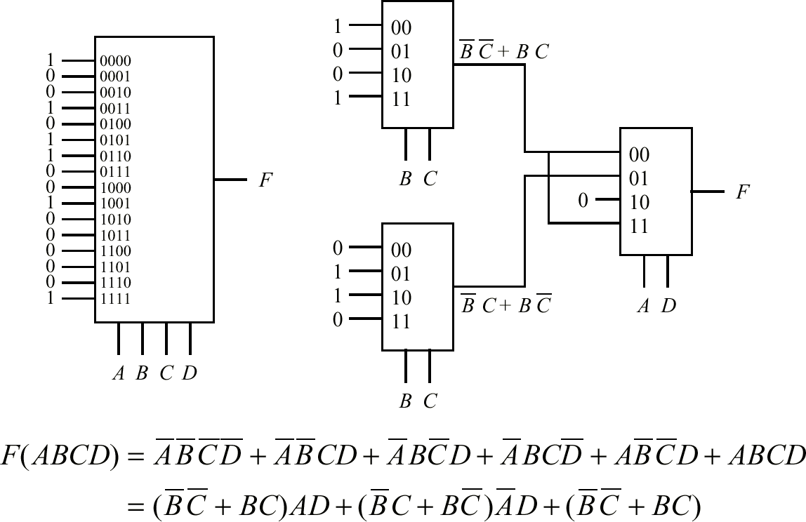
MUX Decomposition

Slide 43
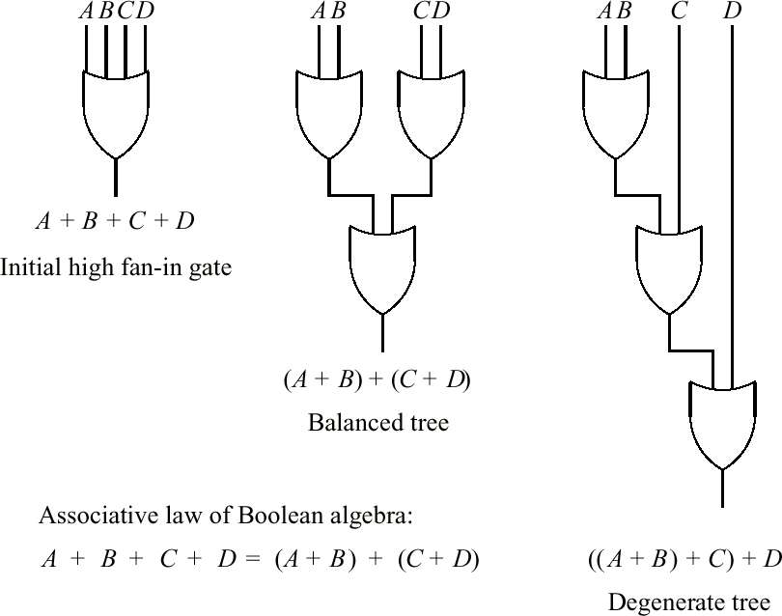
OR-Gate Decomposition
  • Fanin affects circuit depth.

Slide 44
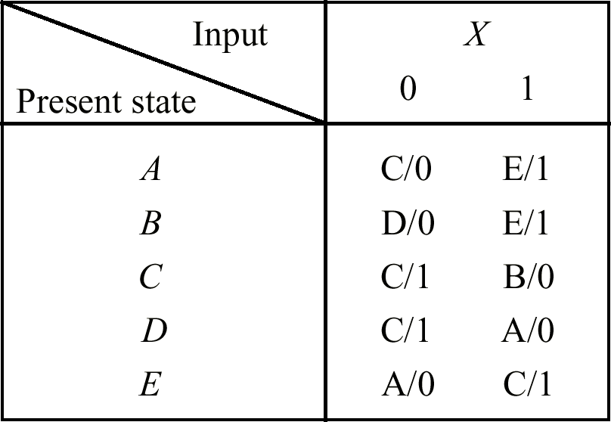
State Reduction
  • Description of state machine M₀ to be reduced.

Slide 45
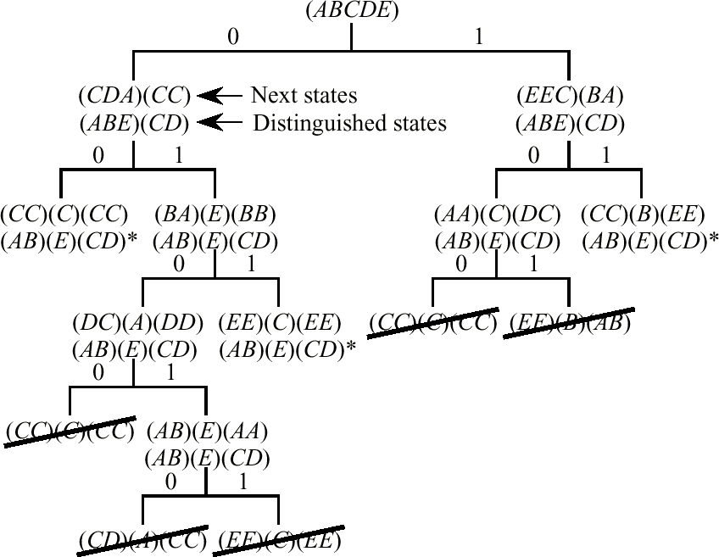
Distinguishing Tree
  • A next state tree for M₀.

Slide 46
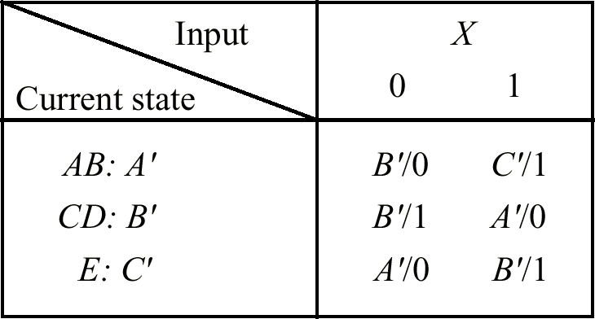
Reduced State Table
  • A reduced state table for machine M₁.

Slide 47
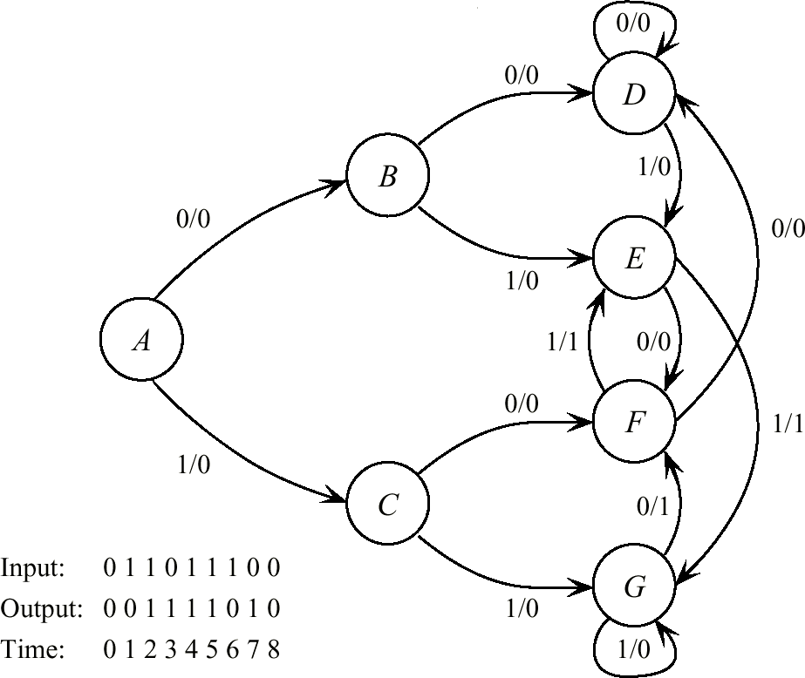
Sequence Detector State Transition Diagram

Slide 48
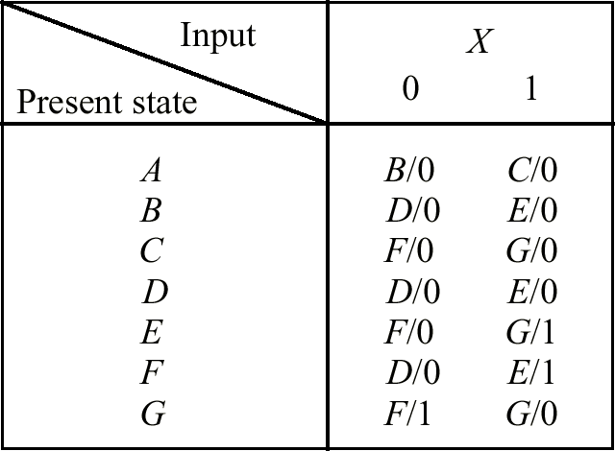
Sequence Detector State Table

Slide 49
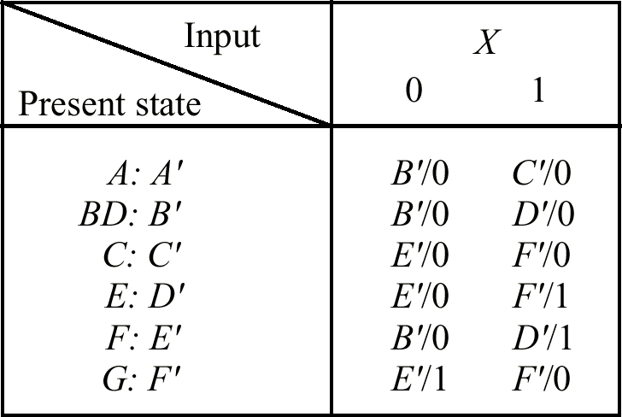
Sequence Detector Reduced State Table

Slide 50
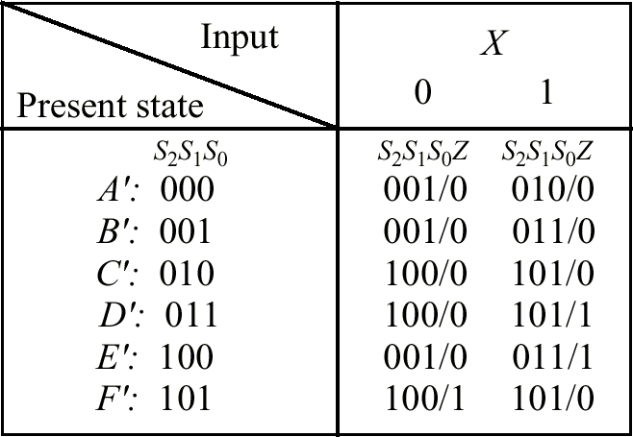
Sequence Detector State Assignment

Slide 51
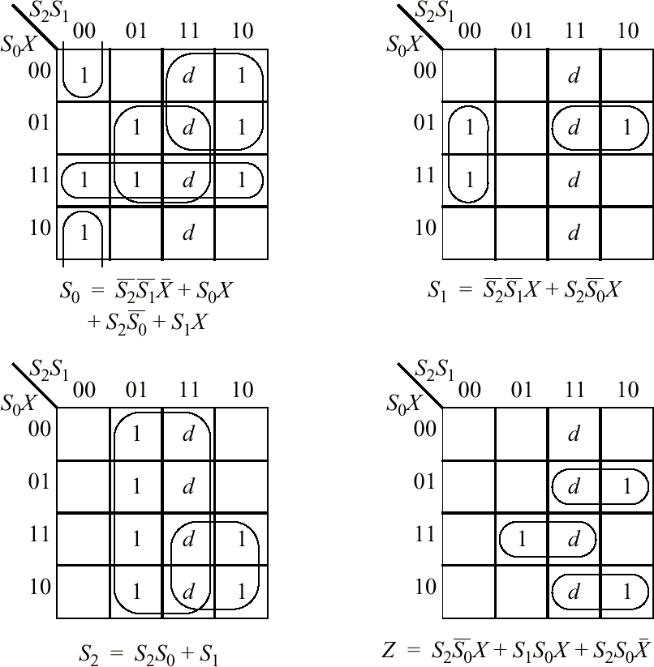
Sequence Detector K-Maps
  • K-map reduction of next state and output functions for sequence detector.

Slide 52
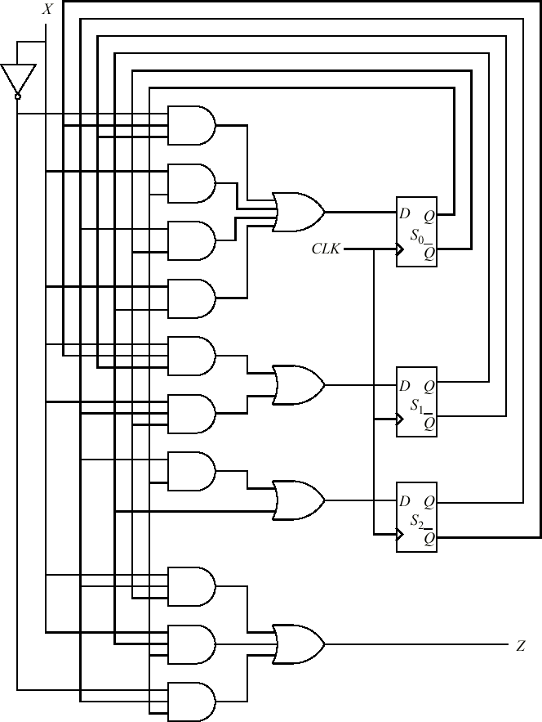
Sequence Detector Circuit

